Slide 1
Robotics Lab
Lecture 2: homogeneous transformation
Damascus University 2019-2020

Slide 2
Homogeneous Matrix

Slide 3
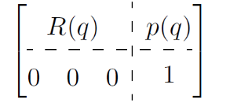
Homogeneous Matrix
R(q) Rotation matrix.
P(a) Translation Vector.

Slide 4
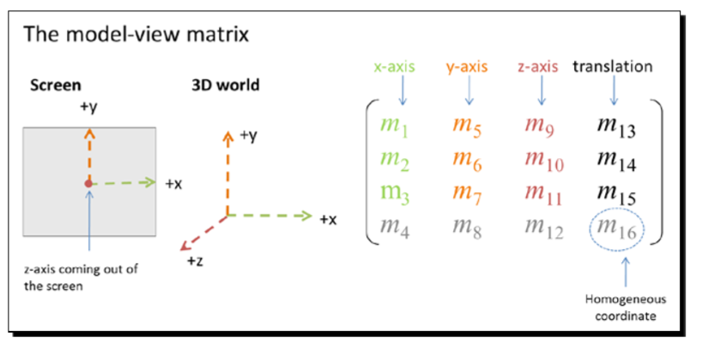
Homogeneous Matrix

Slide 5
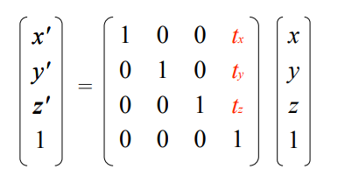
Translate Matrix

Slide 6
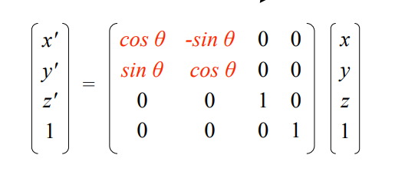
Rotate Matrix (Z-axis)

Slide 7
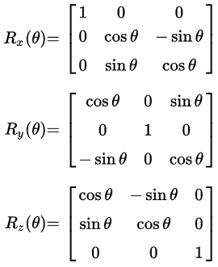
Transformation Matrix

Slide 8
1D Joint

Slide 9
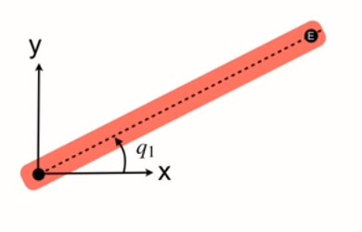
1D Joint
What is the position of point E ??

Slide 10
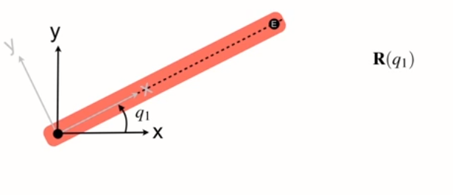
1D Joint

Slide 11
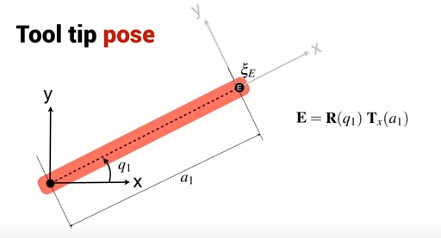
1D Joint

Slide 12
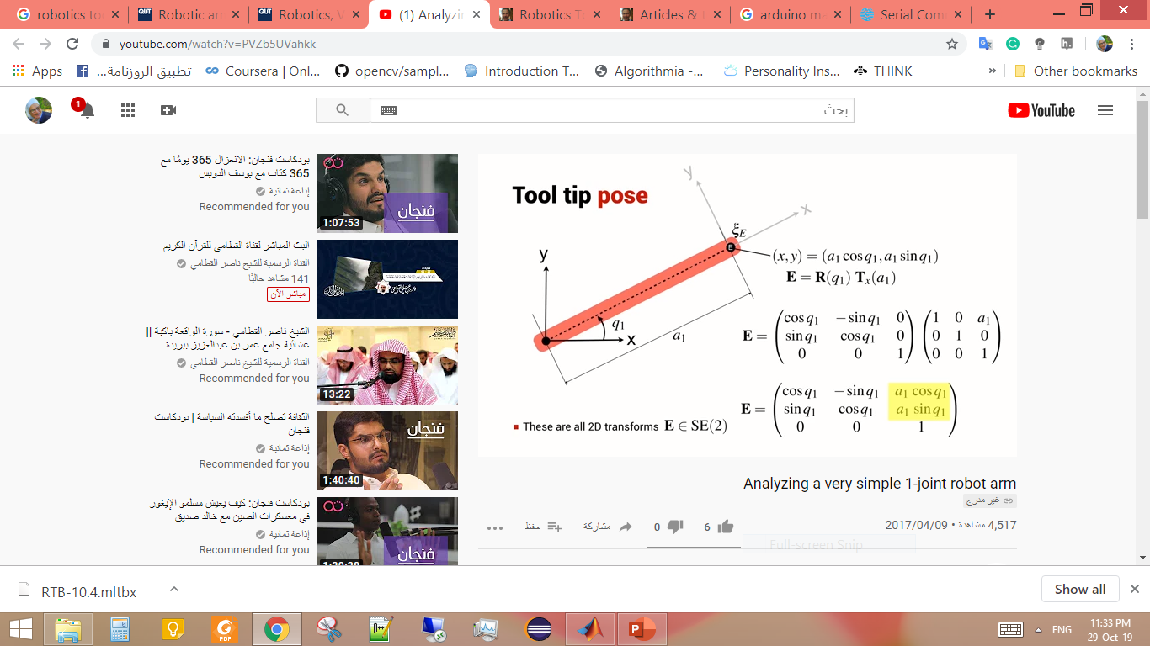
1D Joint

Slide 13
1D Joint

Slide 14
2D Joint

Slide 15
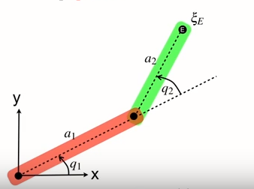
2D Joint
What is the position of point E ??

Slide 16
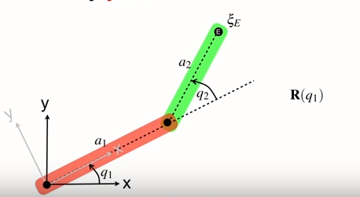
2D Joint

Slide 17
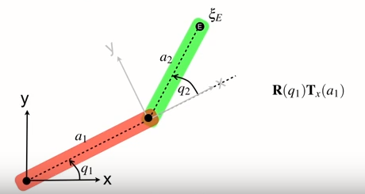
2D Joint

Slide 18
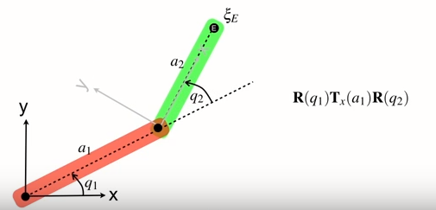
2D Joint

Slide 19
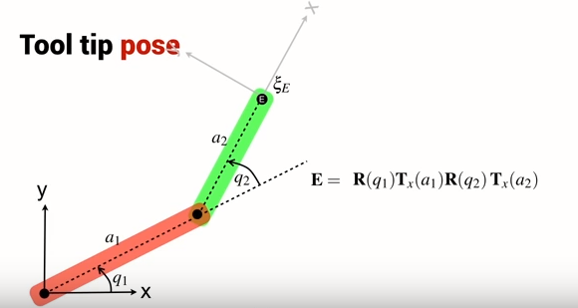
2D Joint

Slide 20
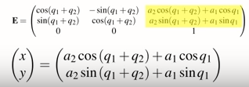
2D Joint

Slide 21
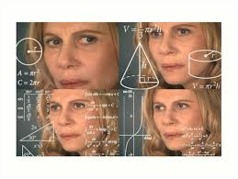
Is Configuration Unique?

Slide 22
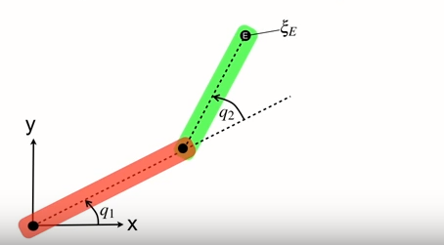
Configuration Not Unique

Slide 23
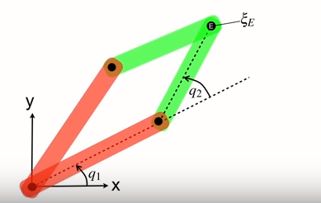
Configuration Not Unique

Slide 24
Robotics Toolbox

Slide 25
Basic Function
syms
  Creates symbolic variables that aren't constants like regular variables, you don't assign any value to them, you can use them to solve expressions
trchain2
    Function we use to calculate homogeneous transformation by describe the series of transformation we need.
mdl_planarN
    Create N dimention joints as seriallink object in workspace to prototype rapidly different joints arm.

Slide 26
Script File
Attachment at :

